Slide 1
Chapter 14 Conjugated Compounds and Ultraviolet Spectroscopy

Slide 2
Learning Objectives
(14.1)
Stability of conjugated dienes: Molecular orbital theory
(14.2)
Electrophilic additions to conjugated dienes: Allylic carbocations
(14.3)
Kinetic versus thermodynamic control of reactions
(14.4)
The Diels-Alder cycloaddition reaction

Slide 3
Learning Objectives
(14.5)
Characteristics of the Diels-Alder reaction
(14.6)
Diene Polymers: Natural and synthetic rubbers
(14.7)
Ultraviolet spectroscopy
(14.8)
Interpreting ultraviolet spectra: The effect of conjugation

Slide 4
Learning Objectives
(14.9)
Conjugation, color, and the chemistry of vision

Slide 5
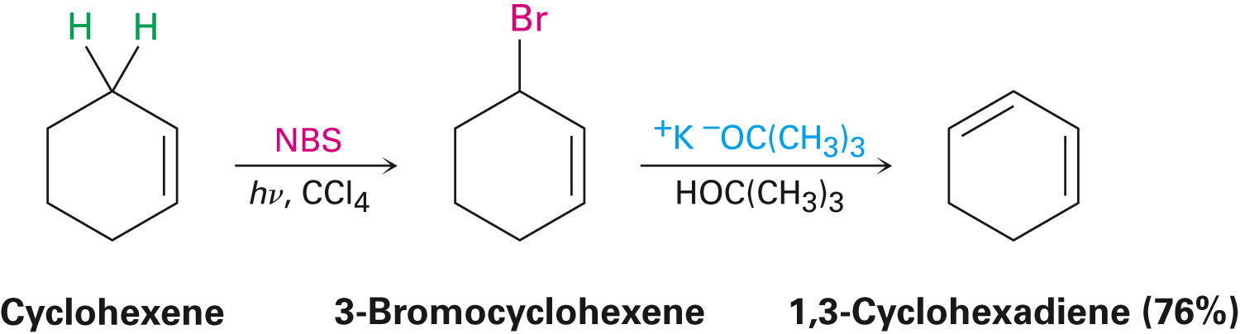
Stability of Conjugated Dienes: Molecular Orbital Theory
Conjugated dienes are typically formed by elimination of HX from an allylic halide
Notes:
Stability of conjugated dienes: Molecular orbital theory

Slide 6
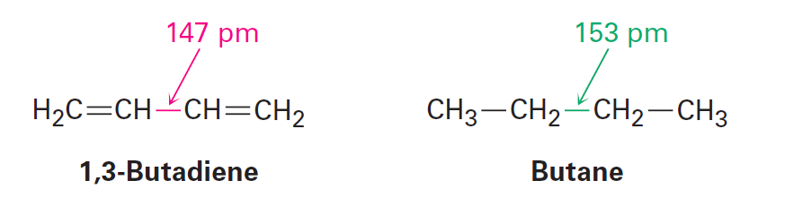
Stability of Conjugated Dienes: Molecular Orbital Theory
Significant properties of conjugated dienes
Possess a shorter central single bond
Possess an increased stability as indicated by heats of hydrogenation
Notes:
Stability of conjugated dienes: Molecular orbital theory

Slide 7
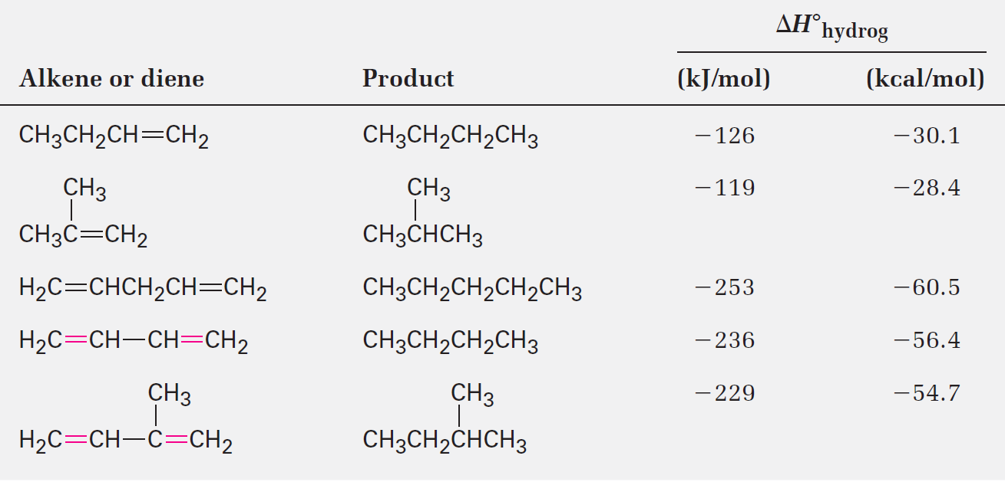
Table 14.1 - Heats of Hydrogenation for Some Alkenes and Dienes
Notes:
Stability of conjugated dienes: Molecular orbital theory

Slide 8
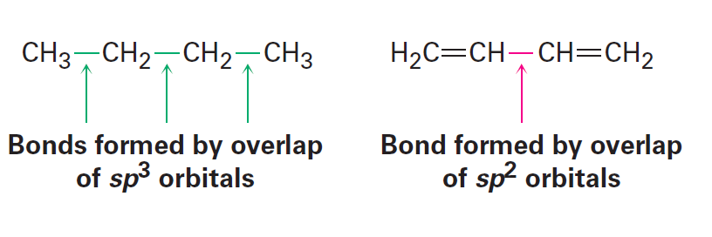
Stability of Conjugated Dienes: Molecular Orbital Theory
According to the valence bond theory, orbital hybridization is the reason behind the stability of conjugated dienes
Central C–C single bond is caused by σ overlap of sp² orbitals on both carbons
sp² orbitals possess 33% s character and sp³ orbitals possess 25% s character
Notes:
Stability of conjugated dienes: Molecular orbital theory

Slide 9
The Molecular Orbital Theory
Interaction between the π orbitals of a conjugated diene causes an increased stability
According to the molecular orbital theory, two π molecular orbitals result when a π bond is formed by the combination of two p orbitals
One π molecular orbital possesses lesser energy than the starting p orbitals causing it to be bonding
The other π molecular orbital possesses a higher energy than the starting p orbitals and has a node between nuclei, causing it to be antibonding
Notes:
Stability of conjugated dienes: Molecular orbital theory

Slide 10
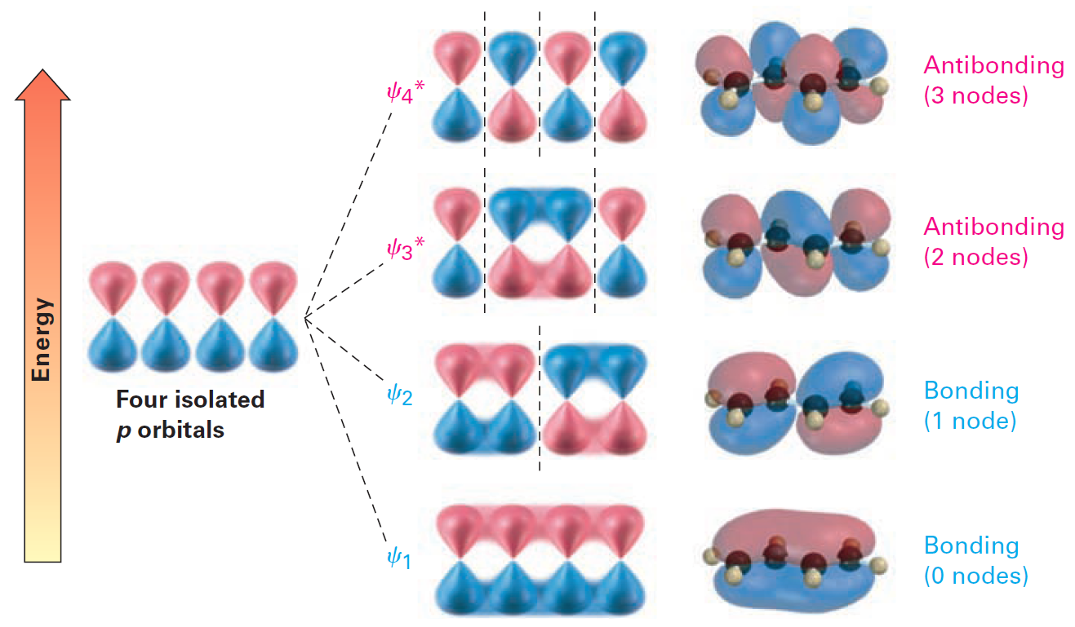
Figure 14.2 - Four π molecular orbitals in 1,3-butadiene
Notes:
Stability of conjugated dienes: Molecular orbital theory

Slide 11
Worked Example
Allene, H₂C=C=CH₂, has a heat of hydrogenation of –298 kJ/mol (–71.3 kcal/mol)
Rank a conjugated diene, a nonconjugated diene, and an allene in order of stability
Solution:
If the heat of hydrogenation for each double bond were the same as that for an isolated bond:
Notes:
Stability of conjugated dienes: Molecular orbital theory

Slide 12
Worked Example
The measured Δh_{hydrog,} –298 kJ/mol, is 46 kJ/mol more negative than the negative value
Allene is higher in energy (less stable) than a conjugated diene, which in turn is less stable than a conjugated diene
Notes:
Stability of conjugated dienes: Molecular orbital theory

Slide 13
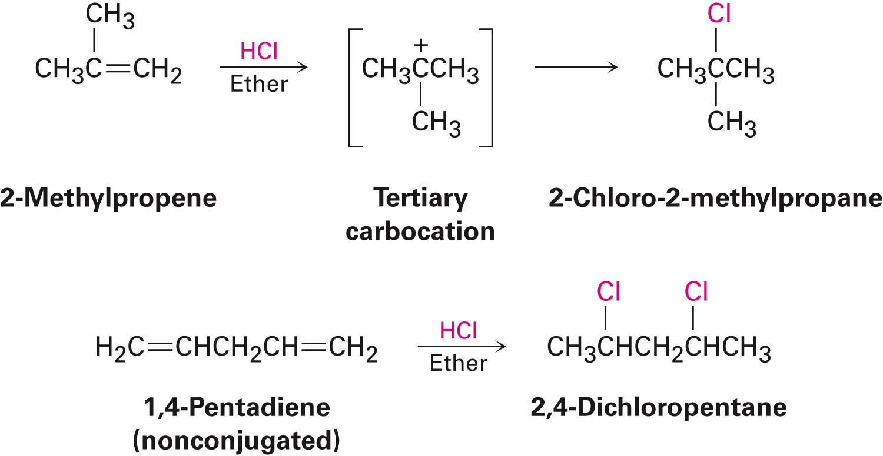
Electrophilic Additions to Conjugated Dienes: Allylic Carbocations
The behaviour of conjugated dienes in electrophilic addition reactions is markedly different from that of typical alkenes
Notes:
Electrophilic Additions to conjugated dienes: Allylic carbocations

Slide 14
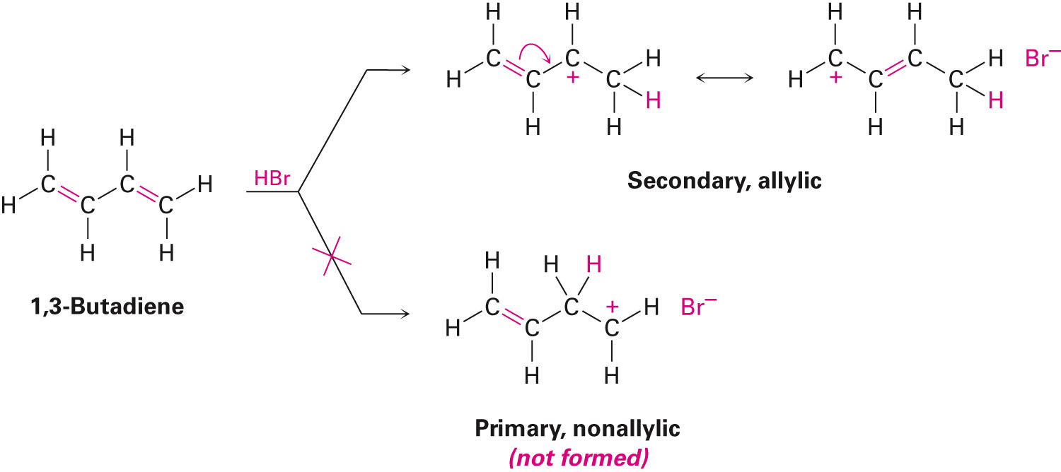
Electrophilic Additions to Conjugated Dienes: Allylic Carbocations
Conjugated dienes undergo electrophilic reactions to produce a mixture of products
1,4-addition products are formed due to the intermediate action of allylic carbocations
Notes:
Electrophilic Additions to conjugated dienes: Allylic carbocations

Slide 15
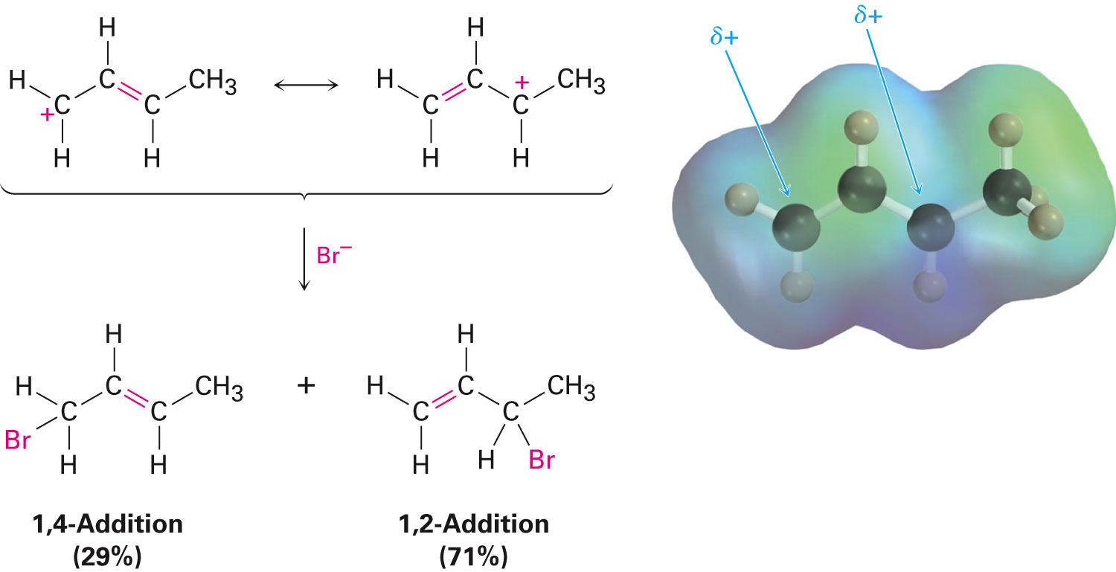
Products of Addition to Delocalized Carbocation
The reaction between Br– the allylic cation occurs either at C1 or C3 as both carbons share the positive charge
Notes:
Electrophilic Additions to conjugated dienes: Allylic carbocations

Slide 16
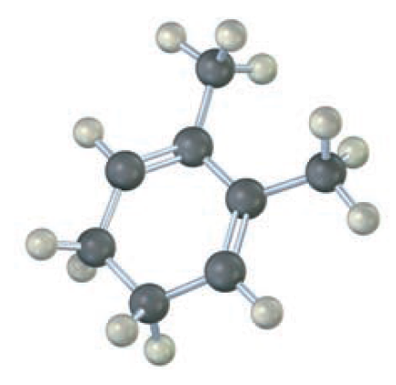
Worked Example
Give the structures of both 1,2 and 1,4 adducts resulting from reaction of 1 equivalent of HBr with the following compound
Notes:
Electrophilic Additions to conjugated dienes: Allylic carbocations

Slide 17
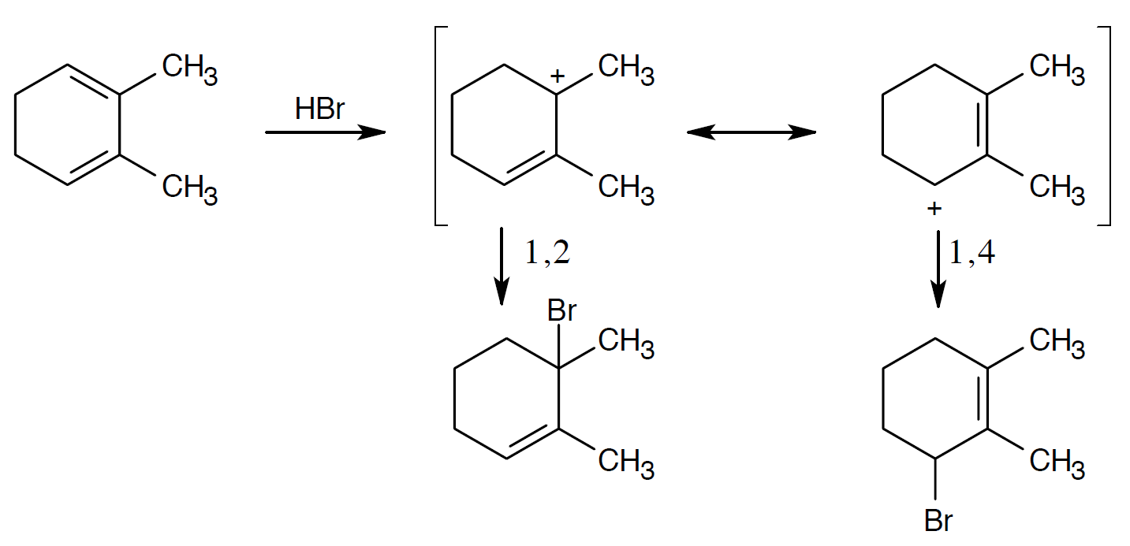
Worked Example
Solution:
Notes:
Electrophilic Additions to conjugated dienes: Allylic carbocations

Slide 18
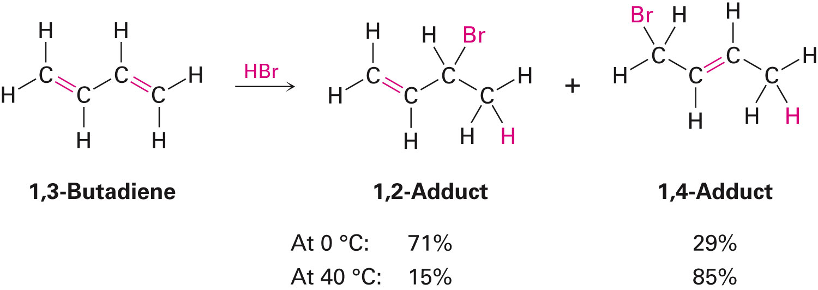
Kinetic versus Thermodynamic Control of Reactions
Addition to a conjugated diene at or below room temperature normally leads to a mixture of products in which the 1,2 adduct predominates over the 1,4 adduct
At higher temperature, the product ratio changes and the 1,4 adduct predominates
Notes:
Kinetic versus thermodynamic control of reactions

Slide 19
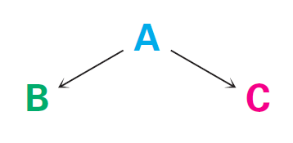
Kinetic versus Thermodynamic Control of Reactions
Consider a reaction with B and C as products
B forms faster than C
ΔG^{ǂ}_{B} < ΔG^{ǂ}_{C}
C is more stable than B
ΔG˚_{C} > Δ G˚_{B}
Notes:
Kinetic versus thermodynamic control of reactions

Slide 20
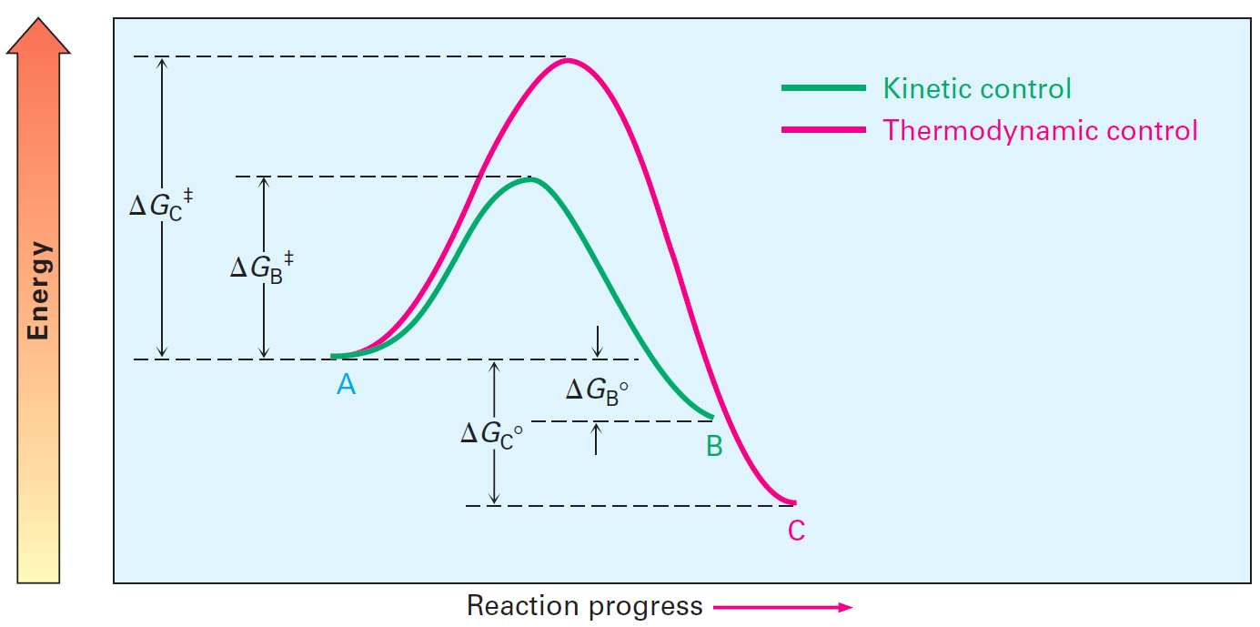
Figure 14.5 - Energy Diagram for Competing Reactions
Notes:
Kinetic versus thermodynamic control of reactions

Slide 21
Kinetic versus Thermodynamic Control of Reactions
Reactions under kinetic control
Product of an irreversible reaction depends only on relative rates and not on stability
B is the major product
Reactions under thermodynamic control
Product of a readily reversible reaction depends only on stability and not on relative rates
C is the major product
Notes:
Kinetic versus thermodynamic control of reactions

Slide 22
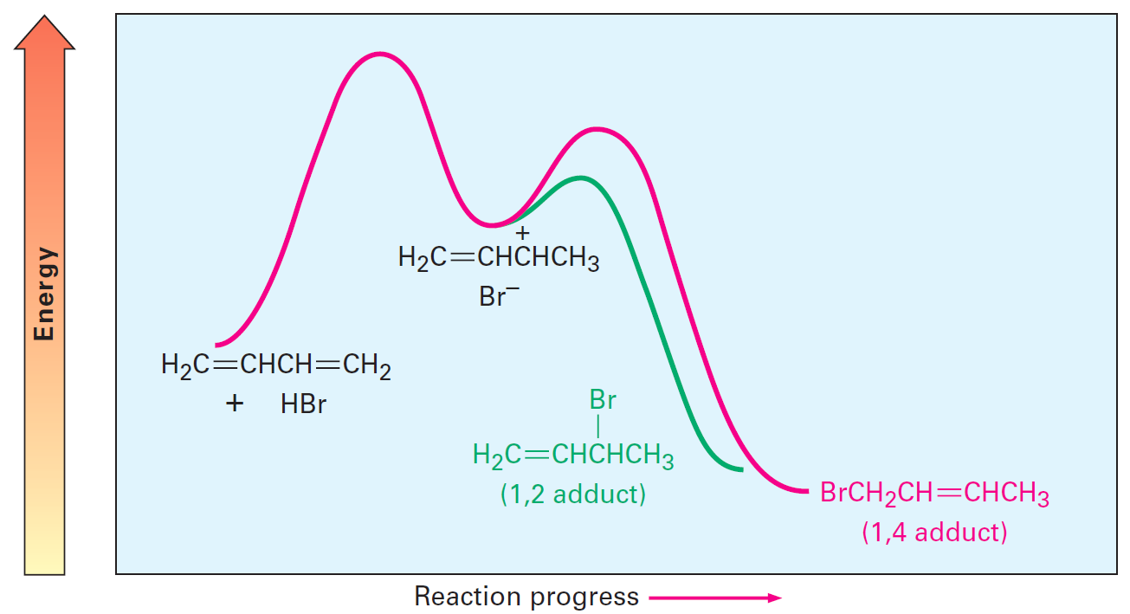
Kinetic versus Thermodynamic Control of Reactions
Applying the principles of kinetic control and thermodynamic control to the electrophilic addition reactions of conjugated dienes
Notes:
Kinetic versus thermodynamic control of reactions

Slide 23
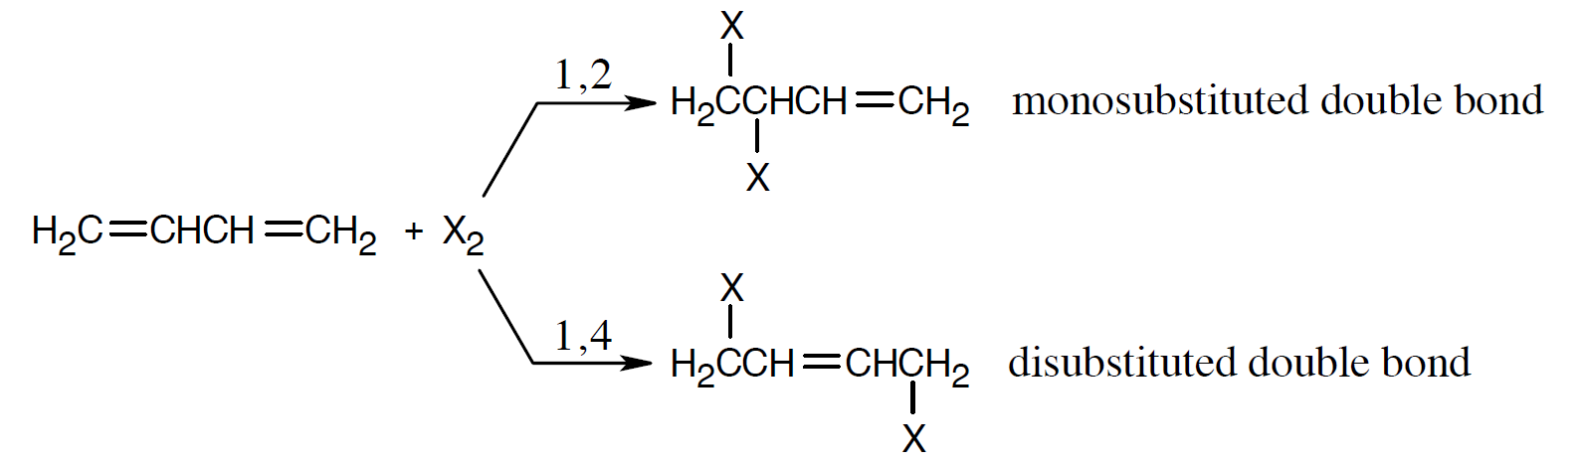
Worked Example
Determine why 1,4 adducts of 1,3-butadiene are generally more stable than 1,2 adducts
Solution:
Disubstituted bonds are more stable than monosubstituted double bonds
Notes:
Kinetic versus thermodynamic control of reactions

Slide 24
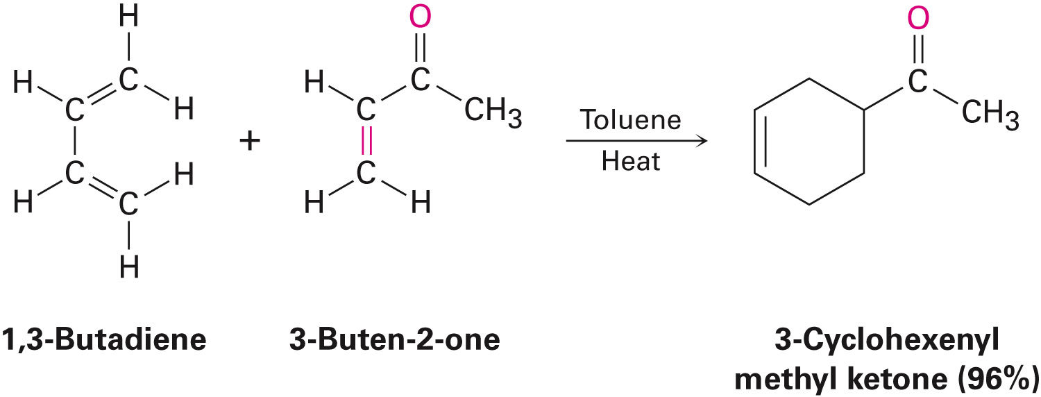
The Diels-Alder Cycloaddition Reaction
Reaction in which conjugated dienes undergo an addition reaction with alkenes to yield substituted cyclohexene products
Used to create cyclic molecules
Notes:
The Diels-Alder Cycloaddition Reaction

Slide 25
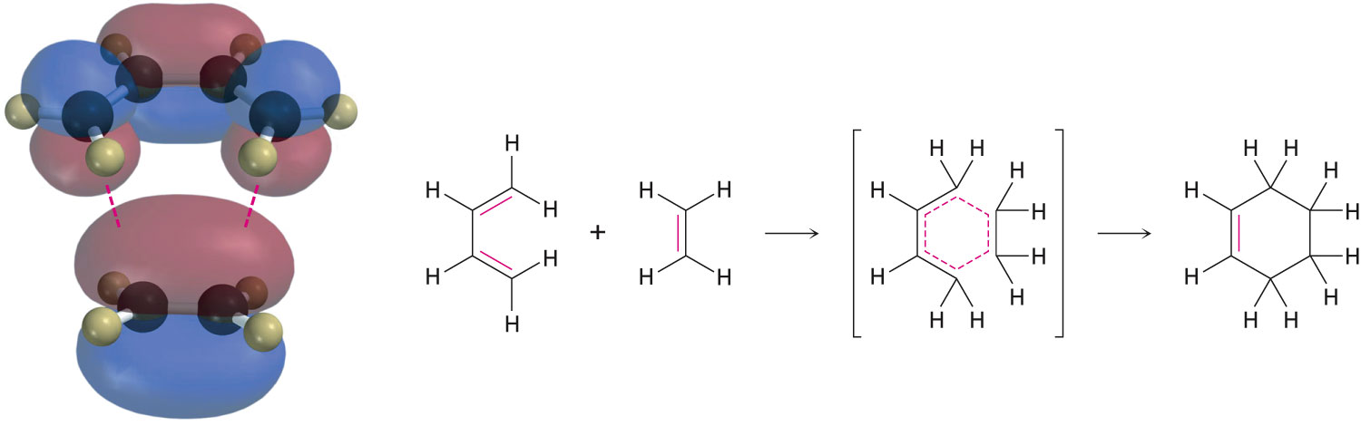
The Diels-Alder Cycloaddition Reaction
The Diels-Adler reaction is a pericyclic process
Pericyclic reactions are single-step reactions that take place in a cyclic redistribution of bonding electrons
Notes:
The Diels-Alder Cycloaddition Reaction

Slide 26
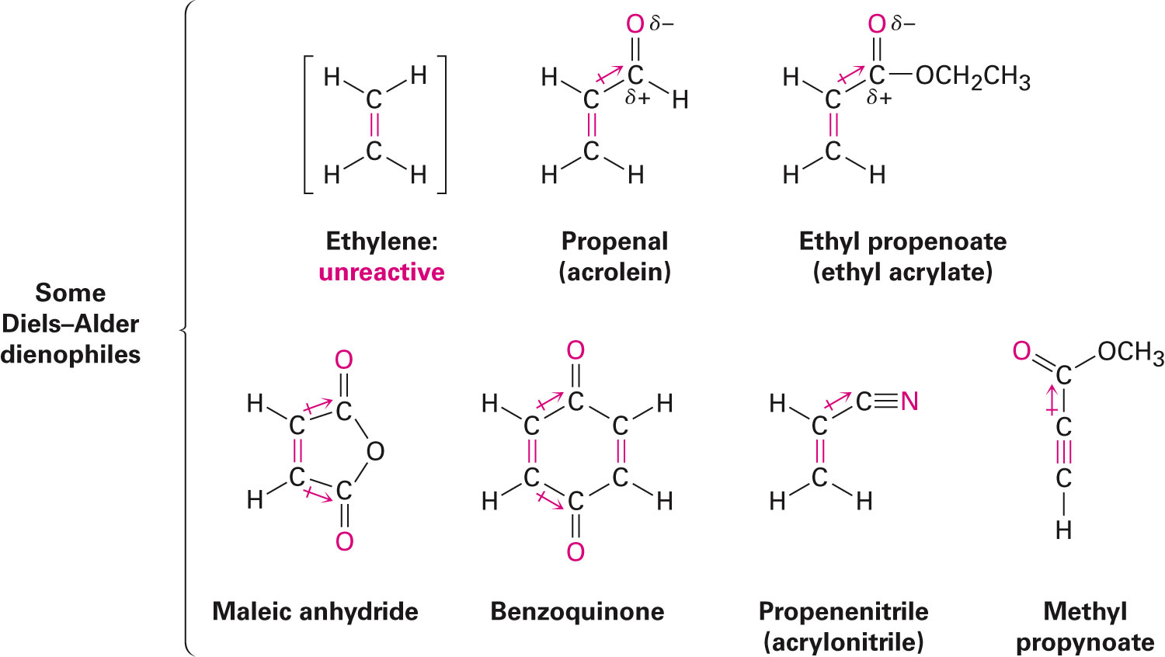
Characteristics of the Diels-Alder Reaction
The Denophile (diene lover)
If the dienophile possesses an electron-withdrawing substituent, the Diels-Adler reaction takes place at a high speed
Notes:
Characteristics of the Diels-Alder Reaction

Slide 27
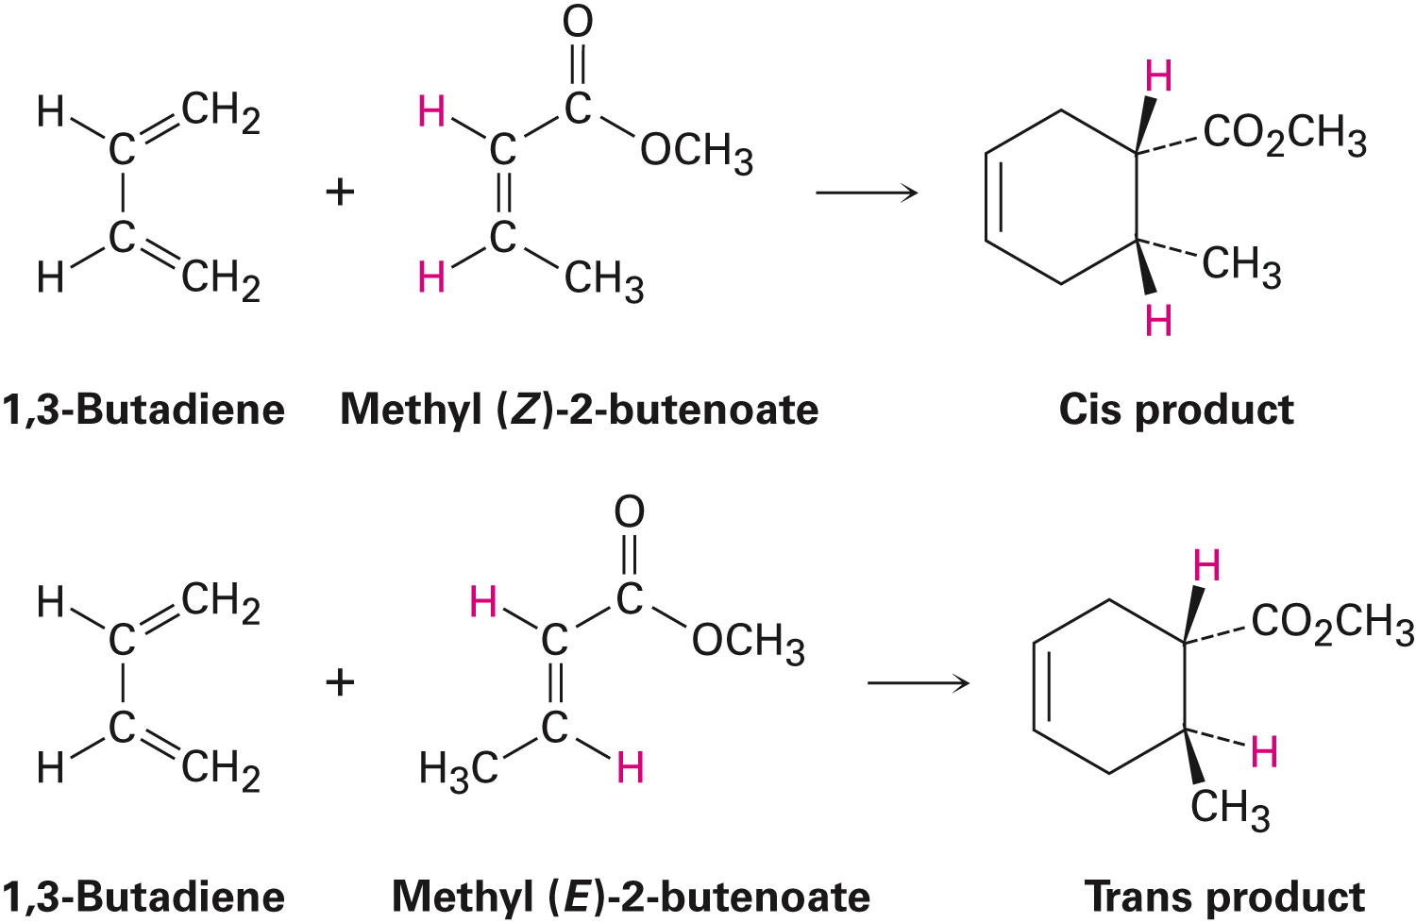
Stereospecificity of the Diels-Alder Reaction
The Diels-Adler reaction is stereospecific
Forms a single product stereoisomer
Retains the stereochemistry of the dienophile
Notes:
Characteristics of the Diels-Alder Reaction

Slide 28
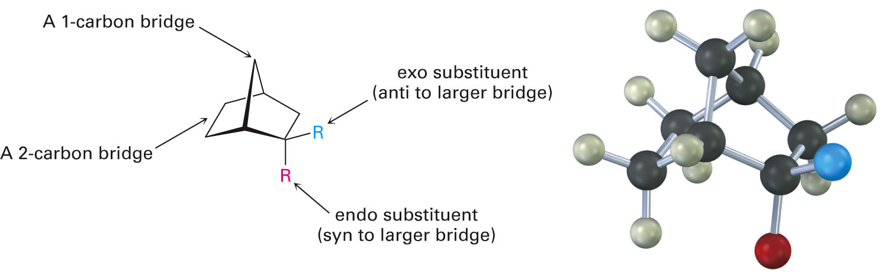
Characteristics of the Diels-Alder Reaction
The orientation of the diene and dienophile partners favors the formation of the endo product instead of the exo product
Endo substituent - Syn to the larger of the 2 bridges
Exo substituent - Trans to the larger of the 2 bridges
Notes:
Characteristics of the Diels-Alder Reaction

Slide 29
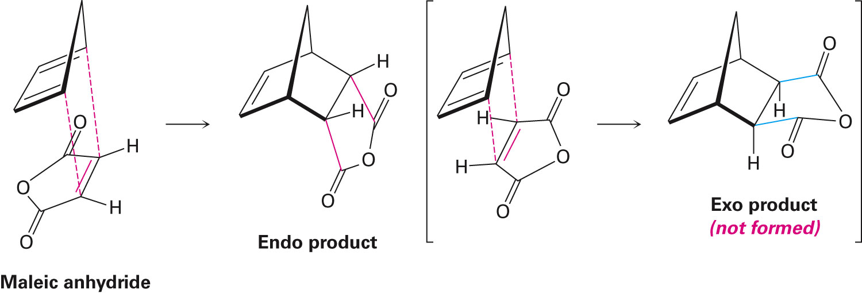
Regiochemistry of the Diels-Alder Reaction
Diels-Adler reactions yield endo products because the reactants are positioned directly above one another
Increased overlap of diene and dienophile orbitals
Notes:
Characteristics of the Diels-Alder Reaction

Slide 30
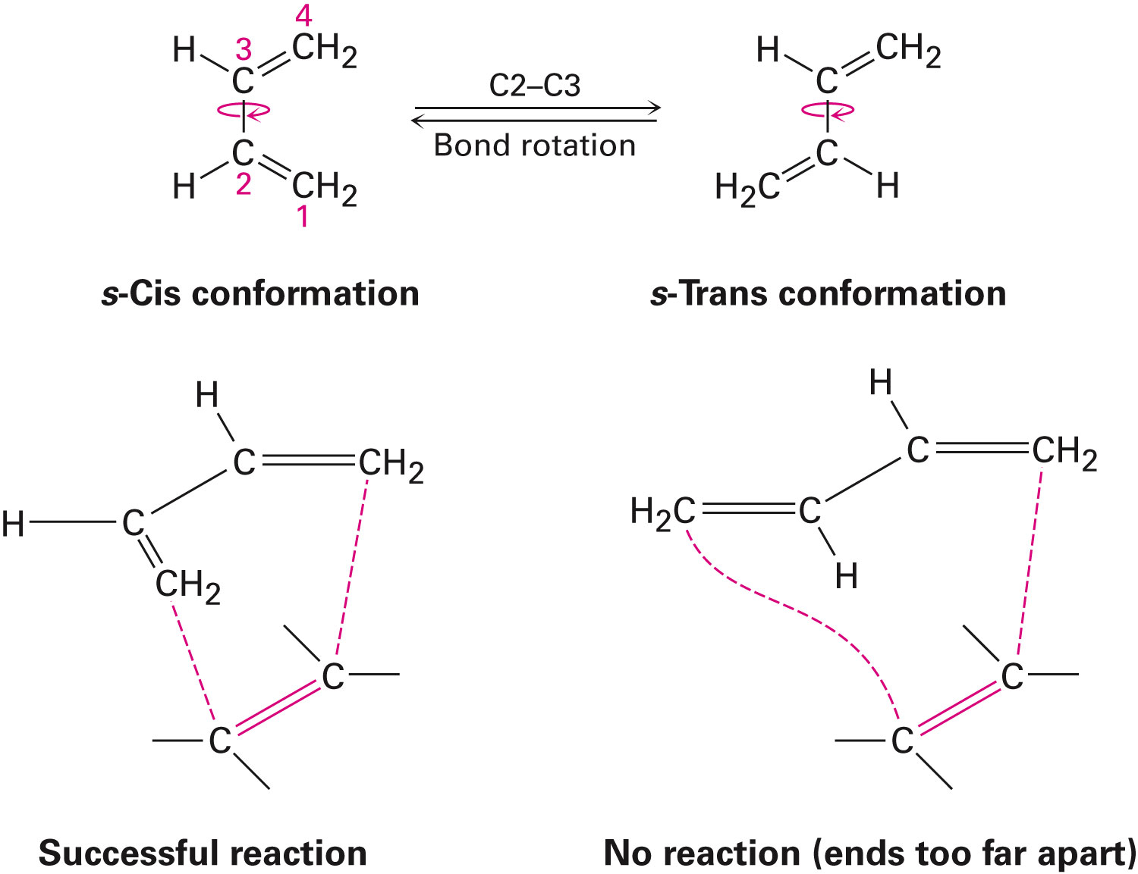
Conformations of Dienes in the Diels-Alder Reaction
Dienes can undergo a Diels-Adler reaction only if they adopt an s-cis conformation
Carbons 1 and 4 are close enough to react through cyclic transition, unlike the s-trans conformation
Notes:
Characteristics of the Diels-Alder Reaction

Slide 31
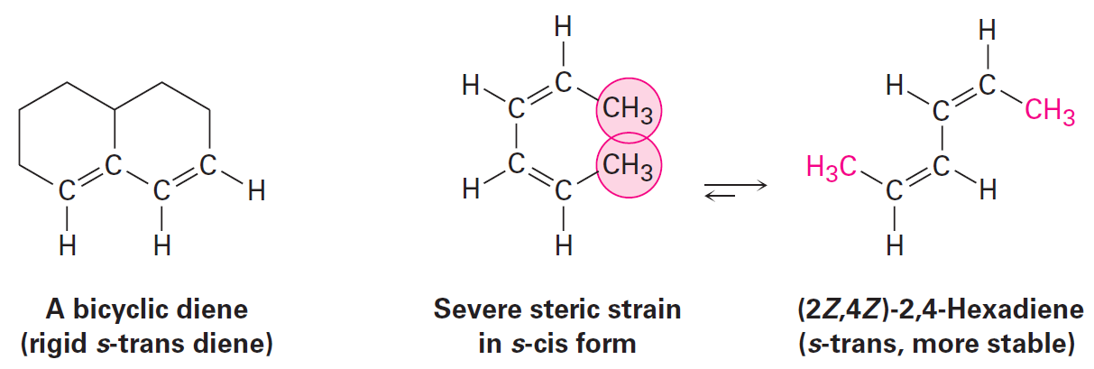
Characteristics of the Diels-Alder Reaction
Dienes that are unable to adopt a s-cis conformation do not undergo Diels-Adler reactions
Some dienes that are set only in the correct s-cis geometry readily react in the Diels-Adler cycloaddition
Notes:
Characteristics of the Diels-Alder Reaction

Slide 32
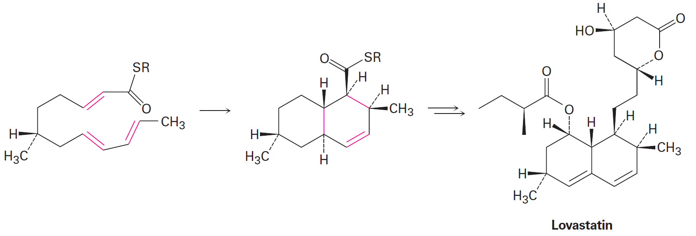
Characteristics of the Diels–Alder Reaction
Biological Diels-Adler reactions occur but are rare
The biosynthesis of lovastatin contains an intramolecular Diels-Adler reaction of a triene
Notes:
Characteristics of the Diels-Alder Reaction

Slide 33
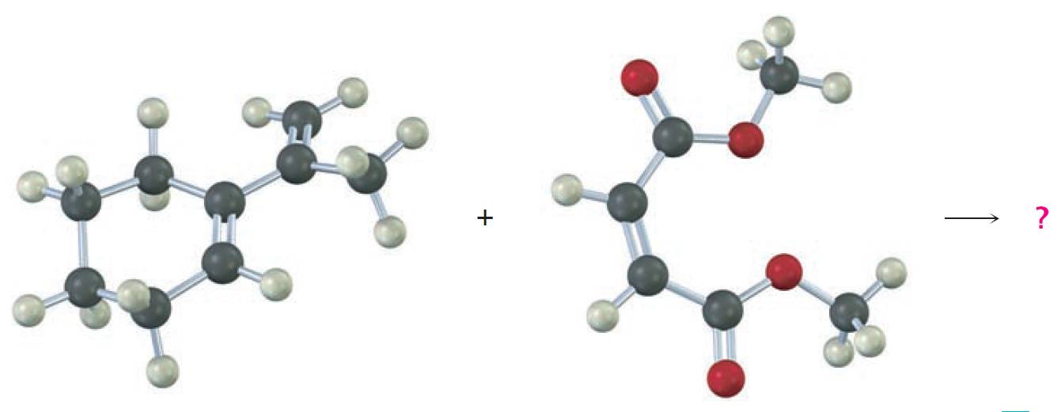
Worked Example
Predict the product of the following Diels-Adler reaction
Notes:
Characteristics of the Diels-Alder Reaction

Slide 34
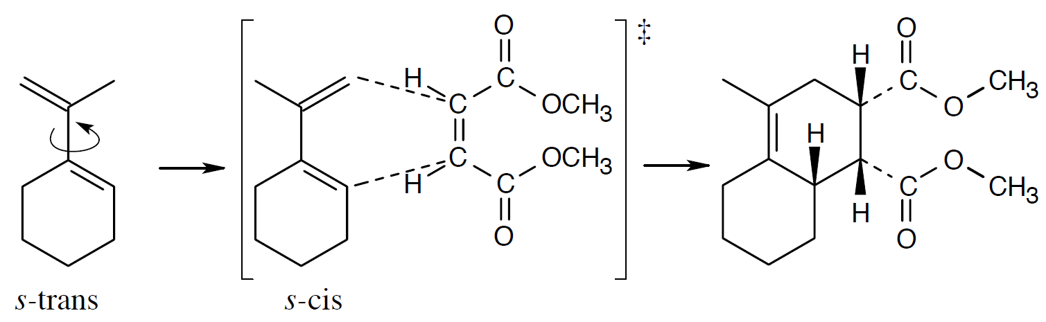
Worked Example
Solution:
Rotating the diene to the s-cis conformation is necessary for the reaction to take place
Notes:
Characteristics of the Diels-Alder Reaction

Slide 35
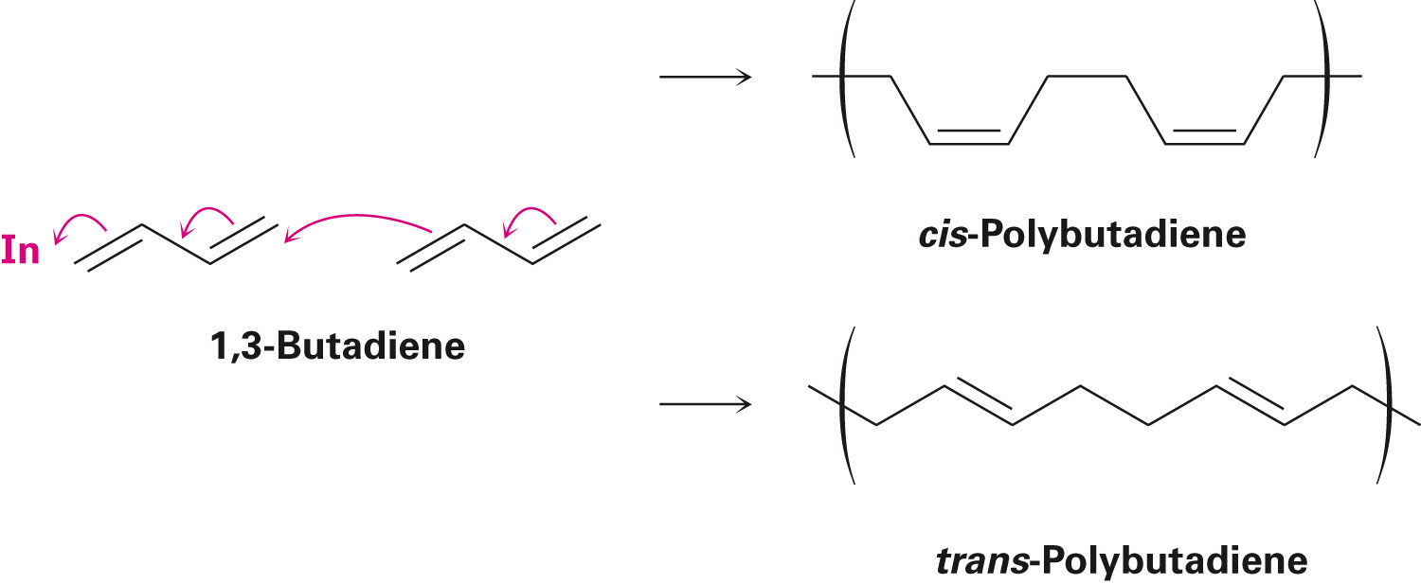
Diene Polymers: Natural and Synthetic Rubbers
Conjugated dienes can be polymerized
The initiator for the reaction can be a radical, or an acid
Polymerization is a 1,4 addition of growing chain to conjugated diene monomer
Notes:
Diene Polymers: Natural and synthetic rubbers

Slide 36
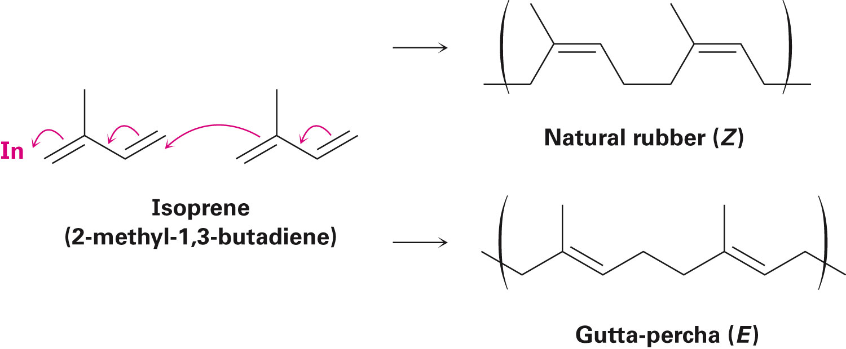
Natural Rubber
Mostly derived from the sap of Hevea brasiliensis
Double bonds of rubber exhibit Z stereochemistry
Gutta-Percha occurs naturally
Notes:
Diene Polymers: Natural and synthetic rubbers

Slide 37
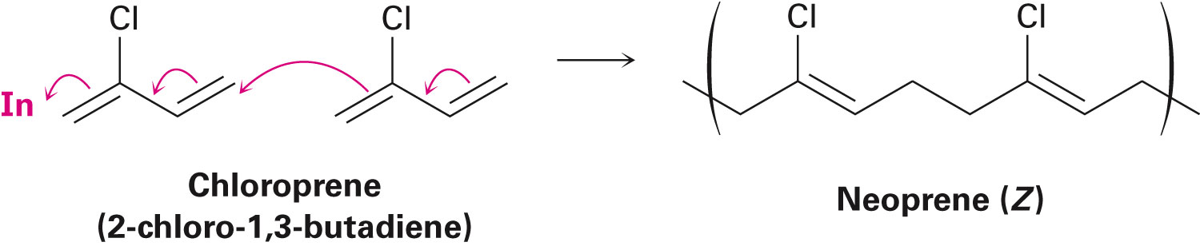
Synthetic Rubber
Diene polymerization is used in the commercial production of rubber
Polymerization of chloroprene yields neoprene
Expensive synthetic rubber with good weather resistance
Notes:
Diene Polymers: Natural and synthetic rubbers

Slide 38
Vulcanization
Natural and synthetic rubbers are too soft to be used in products
Vulcanization involves heating rubber with sulfur which causes the rubber to harden
Sulfur forms bridges between hydrocarbon chains (cross-links)
Elasticity of rubber is due to the irregular structure of polymer chains caused by the double bonds
Double bonds cause polymers to bend
Notes:
Diene Polymers: Natural and synthetic rubbers

Slide 39
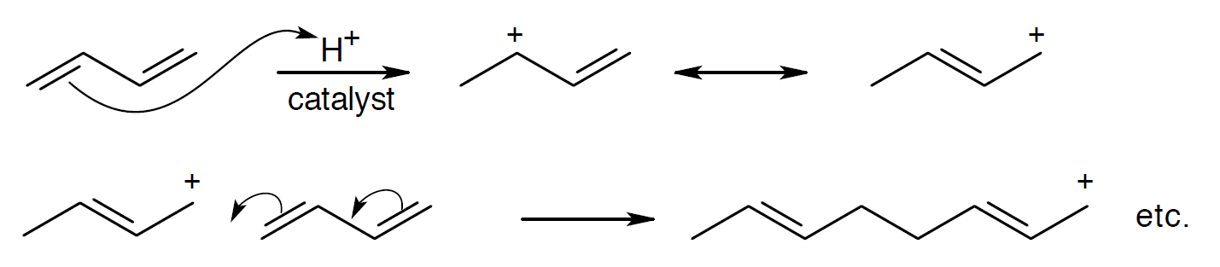
Worked Example
Show the mechanism of the acid-catalysed polymerization of 1,3-butadiene
Solution:
Notes:
Diene Polymers: Natural and synthetic rubbers

Slide 40
Ultraviolet Spectroscopy
Specifically used to determine the molecular structure of conjugated compounds
Not used as widely as mass spectrometry, infrared spectroscopy, or nuclear magnetic resonance
Examines the nature of conjugated π electron system
Notes:
Ultraviolet spectroscopy

Slide 41
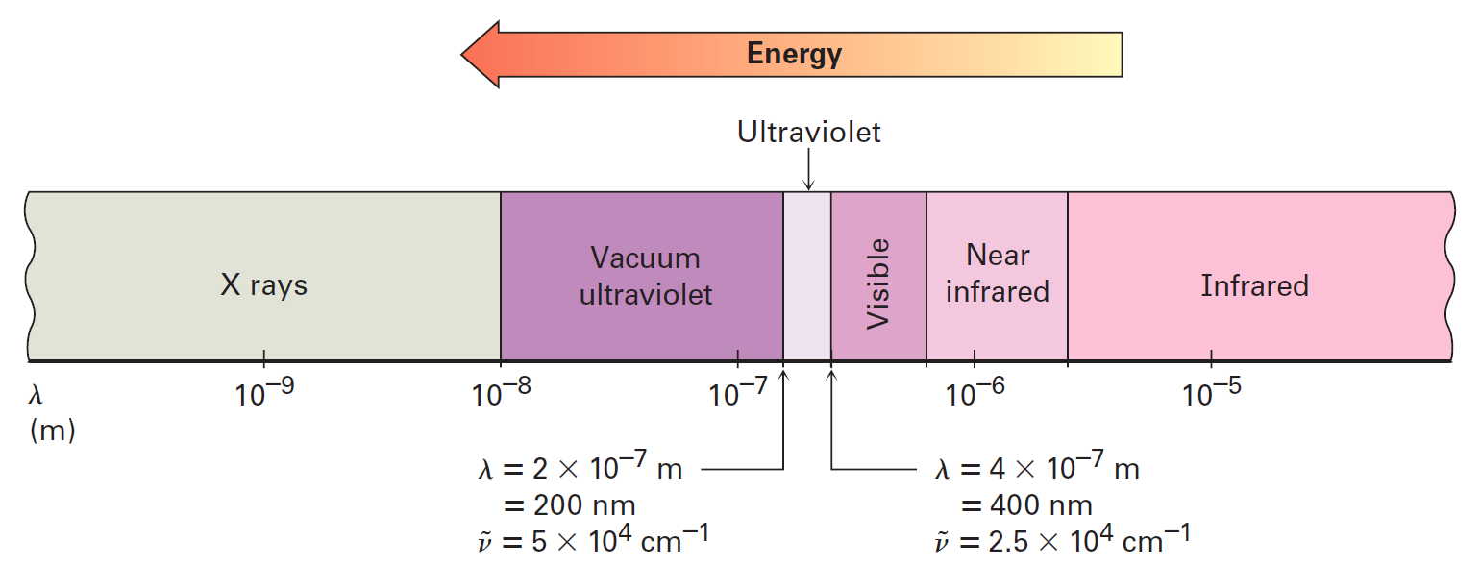
Ultraviolet Spectroscopy
Ultraviolet region of electromagnetic spectrum
Short-wavelength of the visible region to the long-wavelength end of the X-ray region
Scientist’s preferred area of study is the narrow range (2×10^{–7} m – 4×10^{–7} m)
Notes:
Ultraviolet spectroscopy

Slide 42
Principle of UV Spectroscopy
Organic molecules absorb enough energy from UV radiation to cause an electron shift from a lower-energy orbital to a higher-energy orbital
UV irradiation causes a π electron to shift from the highest occupied molecular orbital (HOMO) to the lowest unoccupied molecular orbital (LUMO)
Termed pi to pi star (π to π*) excitation
Notes:
Ultraviolet spectroscopy

Slide 43
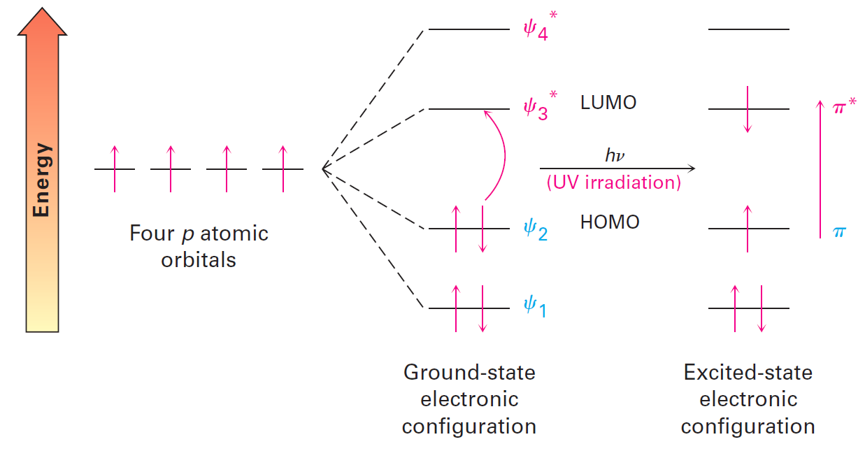
Figure 14.11 - Ultraviolet Excitation of 1,3-butadiene
Notes:
Ultraviolet spectroscopy

Slide 44
Recording an Ultraviolet Spectrum
A sample is irradiated with UV light whose wavelength alternates continuously
Energy is absorbed when the wavelength matches the energy required to cause electron displacement
Absorbed energy is detected and displayed on a chart that plots wavelength versus absorbance (A)
Notes:
Ultraviolet spectroscopy

Slide 45
Molar Absorptivity (ɛ)
It is the expression of absorbed UV light
A = Absorbance
c = Concentration in mol/L
l = Sample pathlength in cm
To determine the concentration of the sample when A, ɛ, and l are known
Notes:
Ultraviolet spectroscopy

Slide 46
Worked Example
Calculate the concentration of vitamin A on a sample whose absorbance at 325 nm is A = 0.735 in a cell with a pathlength of 1.00 cm
Pure vitamin A has λmax = 325 (ɛ = 50,100)
Notes:
Ultraviolet spectroscopy

Slide 47
Worked Example
Solution:
In this problem:
ɛ = 50,100 = 5.01×10⁴ L/mol.cm
l = 1.00 cm
A = 0.735
Notes:
Ultraviolet spectroscopy

Slide 48
Interpreting UV Spectra: The Effect of Conjugation
Wavelength of UV radiation that causes pi to pi star excitation in a conjugated molecule ultimately depends on the nature of the conjugated system
Degree of conjugation has a significant influence on the wavelength of UV absorption
Energy difference between HOMO and LUMO is inversely proportional to the degree of conjugation
Notes:
Interpreting ultraviolet spectra: The effect of conjugation

Slide 49
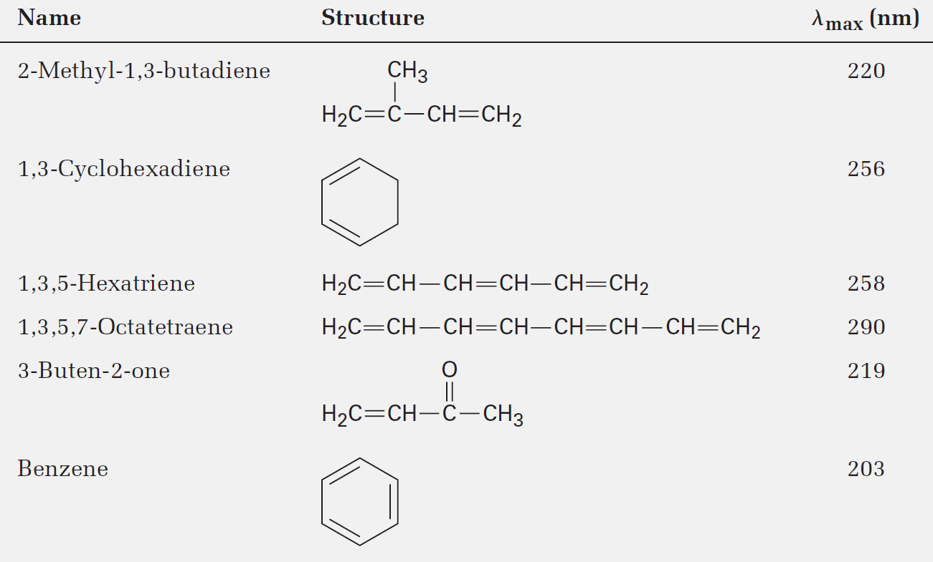
Table 14.2 - Ultraviolet Absorptions of Some Conjugated Molecules
Notes:
Interpreting ultraviolet spectra: The effect of conjugation

Slide 50
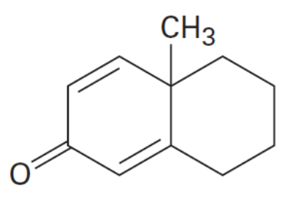
Worked Example
Determine if the following compound exhibits ultraviolet absorptions in the 200 to 400 nm range
Solution:
Since the compound possesses multiple alternate bonds, it would show ultraviolet absorption in the 200–400 nm range
Notes:
Interpreting ultraviolet spectra: The effect of conjugation

Slide 51
Conjugation, Color, and the Chemistry of Vision
Pigmentation of compounds are caused by the chemical structures of colored molecules and the human perception of light
The visible region of the electromagnetic spectrum lies between 400 to 800nm
The ultraviolet spectrum lies adjacent to the visible region of the electromagnetic spectrum
Conjugation systems of some compounds cause their UV absorptions to extend into the visible region
Notes:
Conjugation, color, and the chemistry of vision

Slide 52
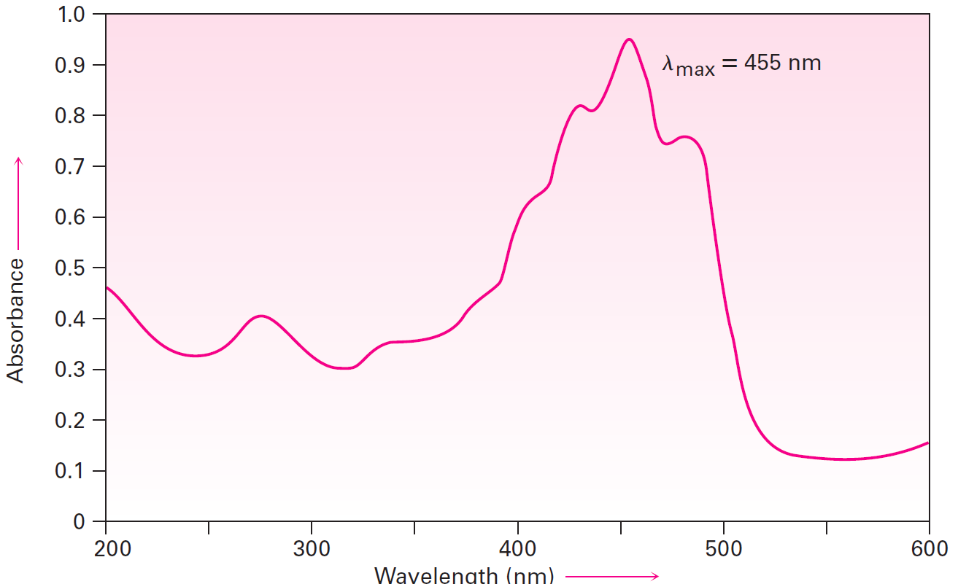
Figure 14.13 - Ultraviolet Spectrum of β-carotene
Notes:
Conjugation, color, and the chemistry of vision

Slide 53
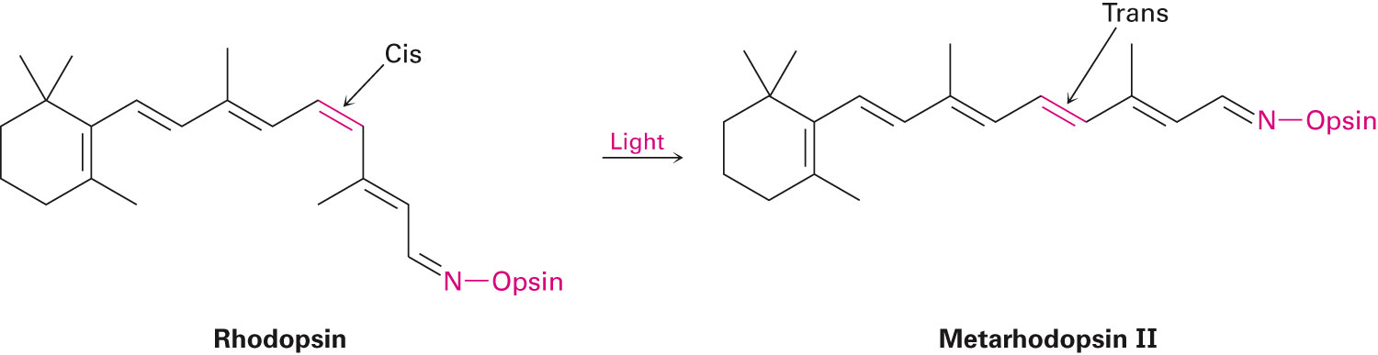
Conjugation, Color, and the Chemistry of Vision
Human vision is possible through the functions of rods and cones in the eye
Rods function in dim light and cones function in bright light
Notes:
Conjugation, color, and the chemistry of vision

Slide 54
Summary
Conjugated diene comprises alternating double and single bonds
Conjugated dienes are more stable than nonconjugated dienes
The formation of 1,4-addition products are exclusive to reactions with conjugated dienes
In a reaction involving formation of 1,2 NS 1,4-addition products, kinetic control is believed to cause the 1,2 adduct and thermodynamic control is believed to cause the 1,4 adduct

Slide 55
Summary
Diels-Adler cycloaddition is another reaction unique to conjugated dienes
Reaction is stereospecific
Ultraviolet spectroscopy is specifically used in the determination of conjugated π-electron systems
Upon UV irradiation, energy is absorbed that causes the π electron to shift from the highest occupied molecular orbital (HOMO) to the lowest unoccupied molecular orbital (LUMO)

